Slide 1


Slide 2
Mission Briefing
Notes:
Quality Product, on time, at best value.
We strive to be the first choice for repair and overhaul.
Engaged workforce
Q-12 survey & Voluntary Protection Program
We seek to understand employees issues so we can fix them
Optimize resources

Slide 3

Mission Briefing

Slide 4

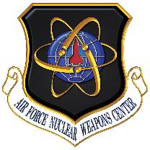


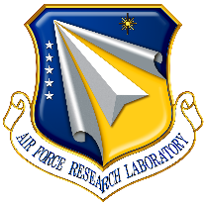


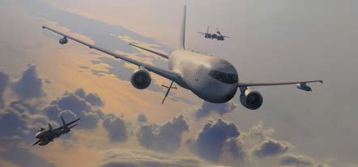
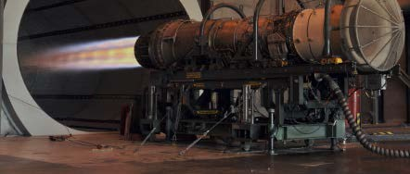

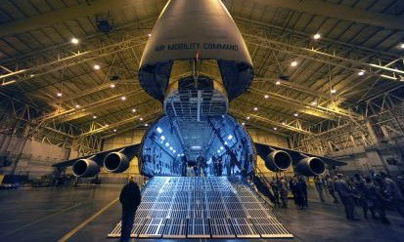
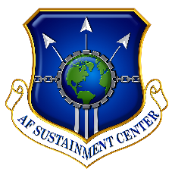
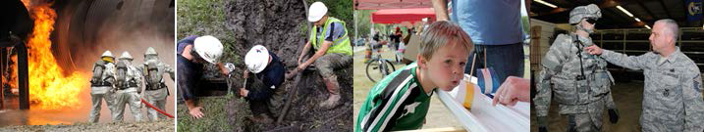
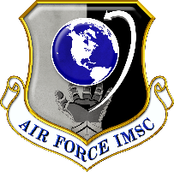
AFMC
Nuclear
Systems
Management
Continue to Strengthen AFMC’s Role in the
Nuclear Enterprise
Discovery &
Development
Advance Today’s & Tomorrow’s Combat
Capabilities through Leading-Edge Technology
Acquire and Support War-Winning Capabilities
“Cradle-to-Grave”
Life Cycle Management
Perform World-Class Test and Evaluation
Test & Evaluation
Provide Sustainment & Logistics Readiness
to Deliver Combat Power for America
Sustainment & Logistics
Support AF-wide Installation and Expeditionary
Combat Support Activities
Installation & Mission Support

Slide 5

Air Force Sustainment Center
MISSION
Provide sustainment and Logistics readiness to deliver combat power for America
VISION
Professional Airmen delivering globally integrated, agile Logistics and sustainment

Slide 6
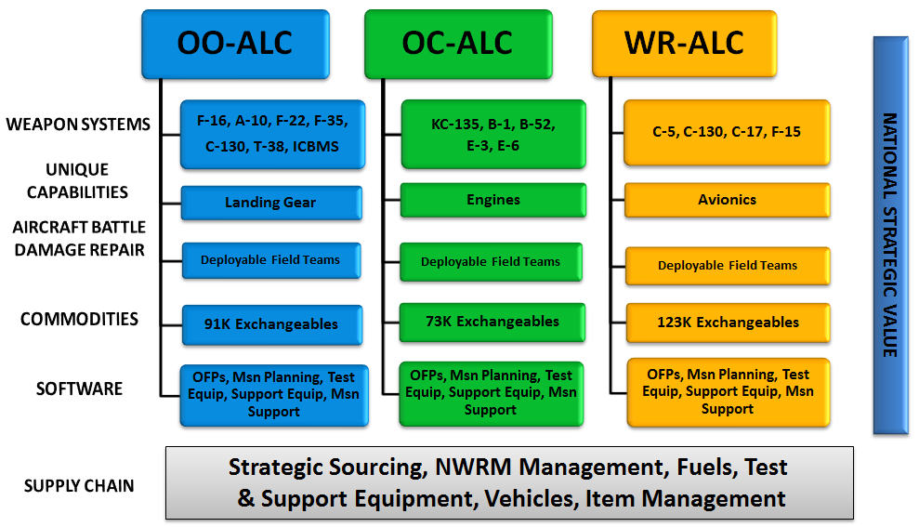
AFSC Generates
Combat Power
Built Right, Ready to Fight

Slide 7
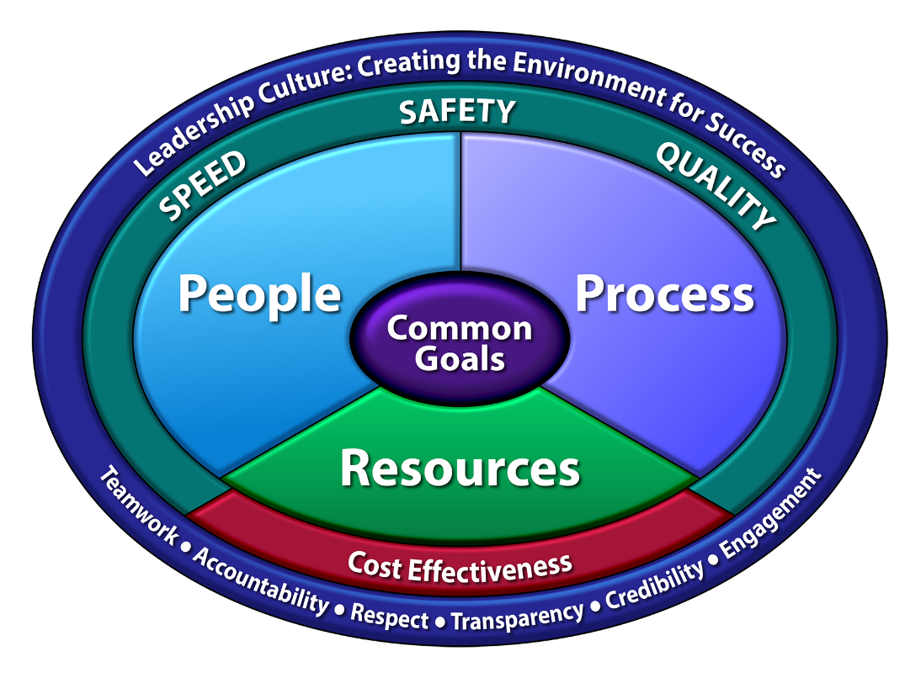
Art of the Possible
Methodology that is focused on the efficient execution of processes
Art of the Possible creates a culture that is centered on identifying and urgently eliminating process constraints affecting production line critical path
Notes:
--------------------------------------------
Art of the Possible is a constraints based system designed to create an environment for success by: Creating a culture of problem-solvers
Defining processes (aka machines) Eliminating constraints Continuously improving
The core tenets of AoP include:
Leadership Model: The Leadership Model is the foundation of AoP that guides AFSC’s management approach, creating an environment for success. The model drives us to meet our common goals through three collective components: Developing our people, Managing our resources, and Improving our processes. Through these collective components, we create an environment where we can achieve the Art of the Possible. Flow Principles: Flow is the action of moving along in a steady continuous stream of adding value; it is the orderly movement of work through a series of established steps. When we define flow, we find where work stacks up = system constraints. We resolve constraints and continue to monitor flow, improving flow each time we resolve a constraint.
Science of Throughput: Takt is the heartbeat of process flow. It defines how often (time) a single unit must be produced from a system. Takt is important because it allows you to schedule level workloads and reduce variability in the process
Takt = (available time) / (required output in that available time)
Data Driven Decisions: If you are not monitoring the system, you are failing. You must trend performance of the processes within each gate to identify constraints to the system and point where to CPI efforts should be directed.
Constraint Resolution: Premise is production systems act much like a chain…only as strong as their weakest link. The weakest link in a production operation is constraint which prevents output of entire system from meeting desired performance. Radiator Chart: The Radiator Chart is the way we execute our game plan and the standardized set of operating principles by which we set up process machines. The elements on the chart touch every part of the enterprise:
The horizontal elements are how the machine is set up
The vertical elements enable the machine to work effectively and efficiently Without these elements working together, the machine will fail
Wall Walk: Provides process improvement overview in terms of machine gates. It identifies gaps and improvement opportunities and requires understanding of what is impacting machine/gate. Wall Walks enable organizational learning and require involvement at all levels to be effective. Wall Walk essentials are Flow, WIP, and Gate Performance.
Tactical Management: At the tactical level, progress of the individual project is tracked visually against a critical path or critical chain. It offers a visual representation of the project activities, presents the time to complete task and overall project, tracks activities, helps synchronize work, and allows focus on the most important steps. It is the way to answer the question: how do you know you are having a good day? AoP is the framework for how the AFSC conducts business and how we strive to achieve world record results in warfighter support.

Slide 8
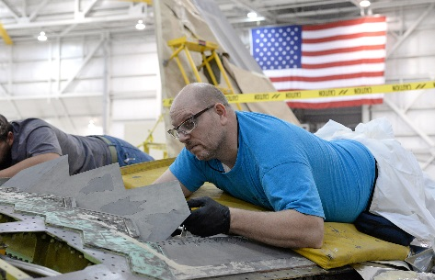
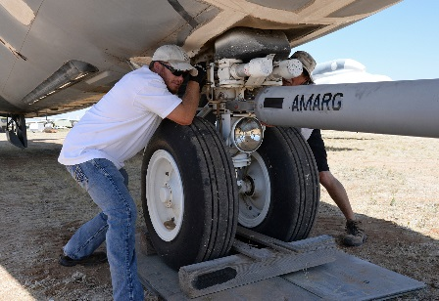
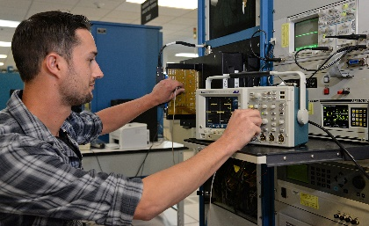
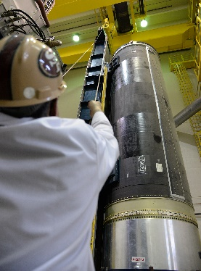
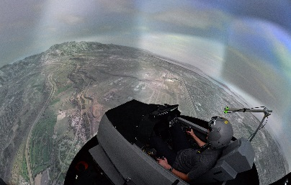
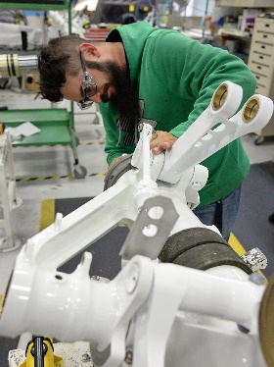
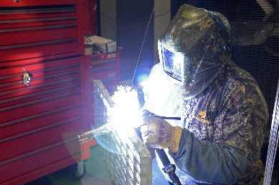
OO-ALC Organization
Ogden Air Logistics Complex
Commander
Vice Director
Vice Commander
309th Aerospace Mx and Regeneration Group
Chief of Staff
309th Aircraft Mx Group
Engineering
309th Commodities Mx Group
Business Operations
309th Electronics MX Group
Financial Management
309th Missile Mx Group
Inspector General
309th Mx Support Group
Aerospace Sustainment
309th Software Eng. Group
Quality Assurance
Safety
Built Right, Ready to Fight

Slide 9
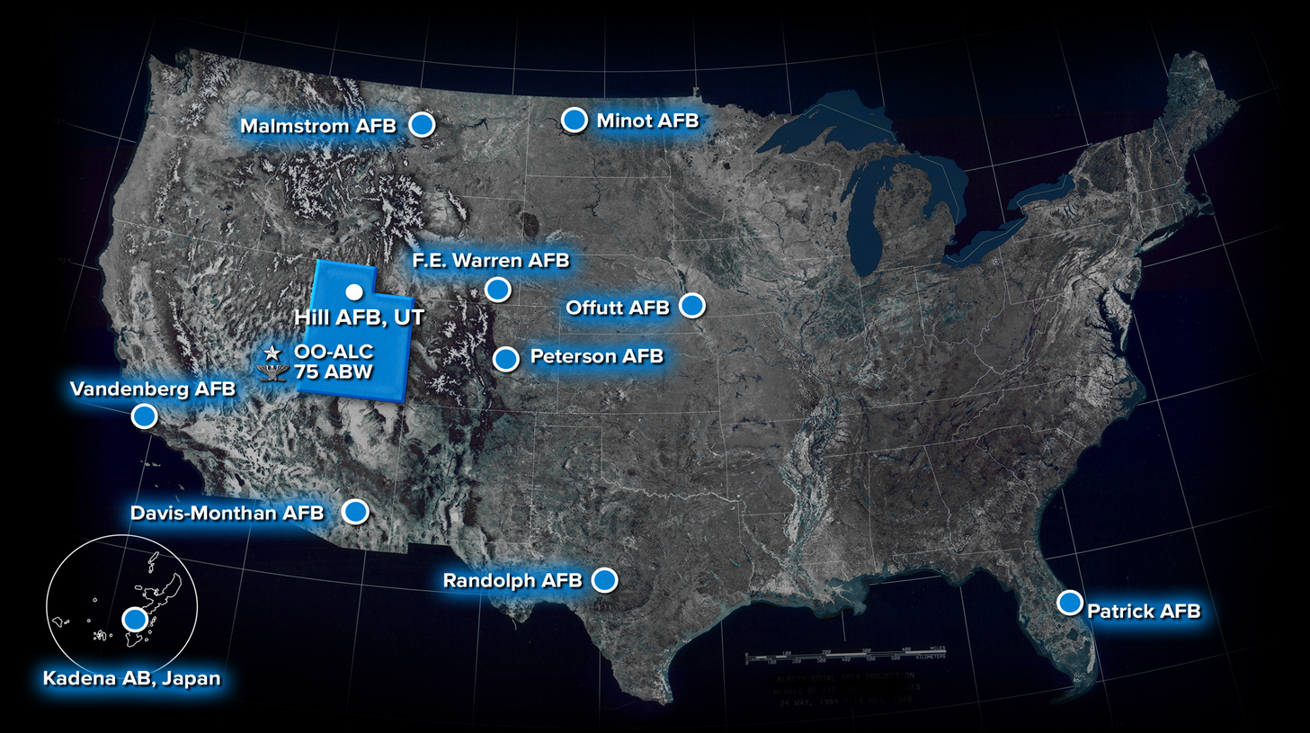
OO-ALC
Operating Locations

Slide 10
OO-ALC Mission, Vision, Motto
Mission
Produce – Support – Sustain for the Warfighter
Vision
Recruit, develop, and retain empowered Airmen producing war-winning products and services for the Warfighter
Motto
Built Right, Ready to Fight

Slide 11
OO-ALC Goals
Resources:
Optimize key resources required to meet current and future mission needs with priority given to the nuclear enterprise and fifth generation aircraft
People:
Ready our Airmen with a safe work environment, mentoring, and professional development opportunities
Process:
Improve processes that are essential to meeting FY18/19 Complex Art of the Possible “Road to…” goals
Mission Execution:
Improve on-time delivery rates, annual manpower yield, and the output per man-day while meeting established product quality standards

Slide 12
OO-ALC Facts
Facilities
295 Buildings
11 Operating Locations
5.2M Sq. Ft Production Floor
0.5M Sq. Ft Missile Storage
Production
~275 Aircraft Overhauled Annually
~82,767 Exchangeable End Items
Produced Annually
FY19 | Produced YTD | Projections
A-10 | 35 | 35
C-130 | 16 | 18
F-16 | 134 | 138
F-22 | 16 | 16
F-35 | 18 | 18
T-38 | 16 | 22
QF-16 | 10 | 15
T-1A | 4 | 10
Total | 249 | 272
Budget
$2.193 Billion Annual Budget
~$886M Annual Material Costs
~$912M Annual Payroll
~$361M Annual Contracts
~$69M Capital Purchases
Notes:
DFT-Depot Field Team- repairs conducted in the field by TDY personnel from Hill.
ICBM Comp’s – Is total components
DFT= Depot Field Team
7th Largest employer in the state of Utah
We would rank 954th in terms of budget for all companies in the US.

Slide 13
OO-ALC
Demographics

Slide 14
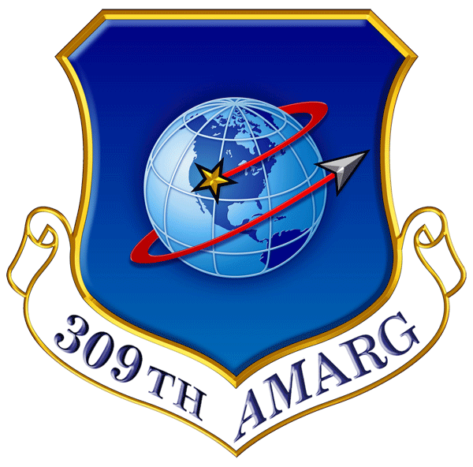
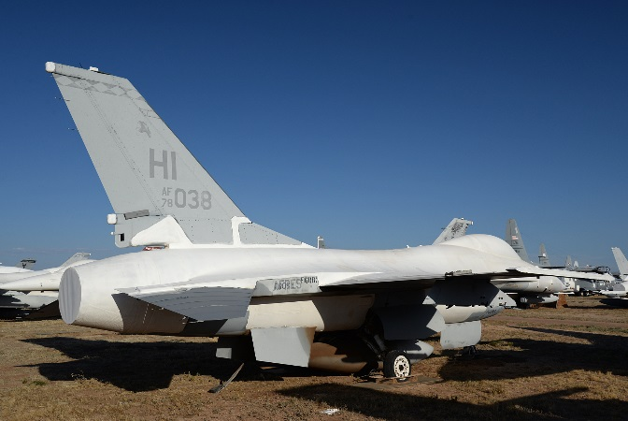
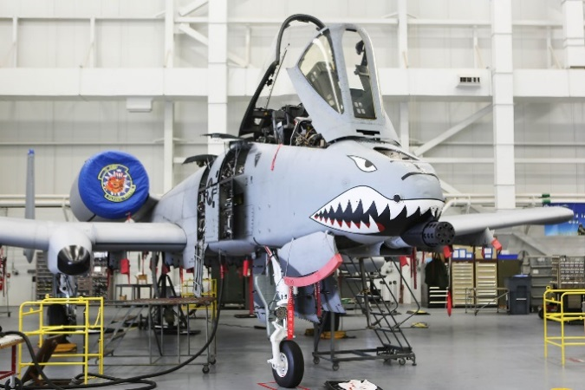
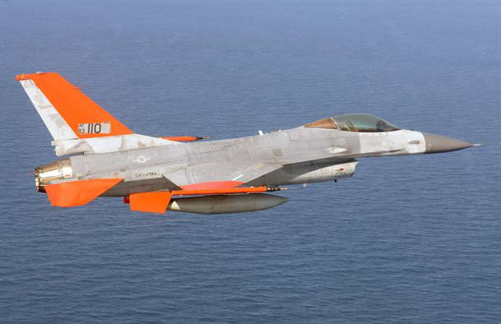
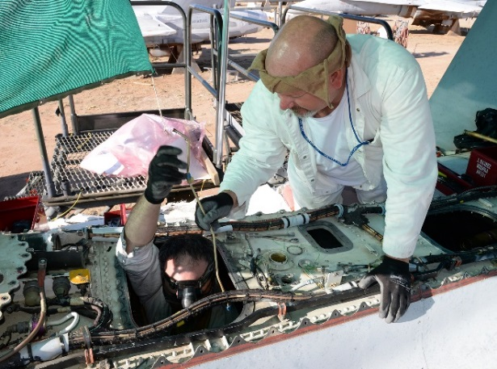
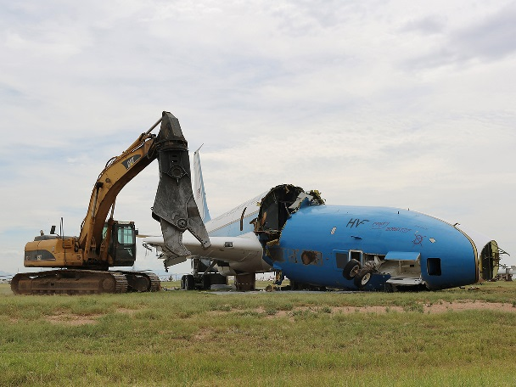
309th Aerospace Maintenance & Regeneration Group
Aerospace Storage and Preservation
Depot-Level Maintenance Overflow
Regeneration
Parts Reclamation
Disposal
Built Right, Ready to Fight
Notes:
AMARG aka “The Boneyard” … A national-level air power reservoir
Storage and Preservation
- Store roughly 4000 aircraft, 7000 engines, and 517,000 pieces of aircraft tooling on 2600 acres; largest facility of its kind in the world.
Depot Level Maintenance overflow
C-130 Outer wings
A-10 ARC-210 and LARS V-12 Desert Speed Line Mods
Regeneration
-F-16s as aerial targets
- KC-130T for FMS
- C-27s for Coast Guard
- Overland F-18s for Marines, and F-16 for Indonesian Air Force
Parts reclamation
- Reclaim average of 8000 parts annually to support DoD warfighter
Disposal
- Dispose of roughly 300 aircraft/engines annually (F-4s, A-6s, OH-58 obsolete weapon systems topped the list most recently
Efficiency Initiatives
Ceramic roof coatings “keep facilities 25 to 35 degrees cooler just by reflecting heat
LED lighting, 35% less energy usage with 25% brighter light than conventional lighting
Micro-turbine remote power (Shelter and Oasis), run quite, use natural gas, total off the grid remote power capability
MILCON projects
- Alternative Energy Aircraft Hangar commissioned 7 Dec 2015; houses F-16 and A-10 production machines
Squadron Consolidation
Consolidate Commodities Reclamation & Storage & Disposal squadrons

Slide 15
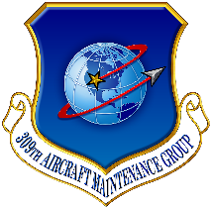
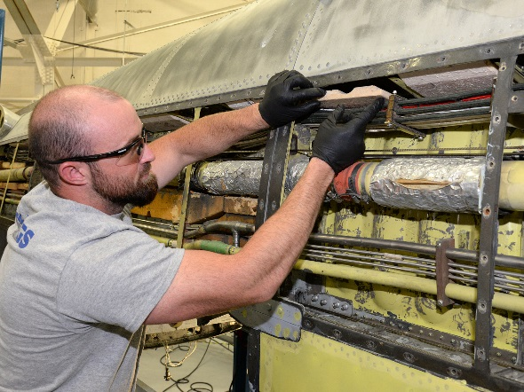
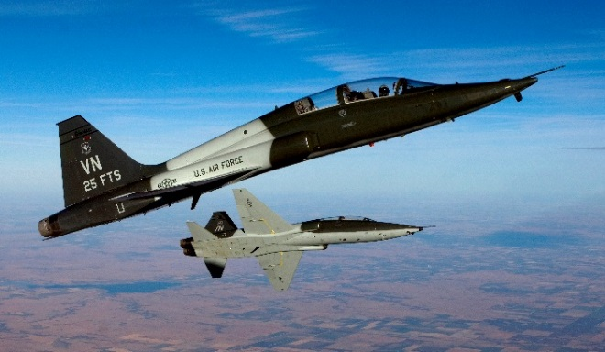
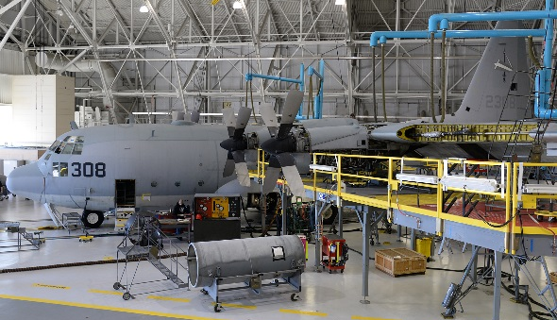
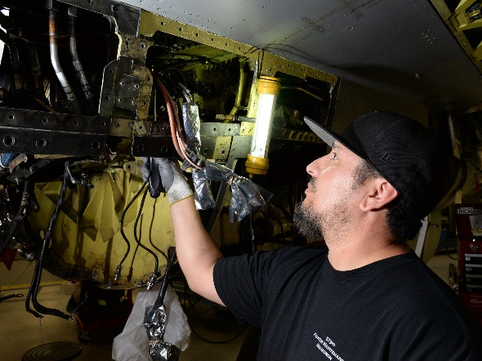
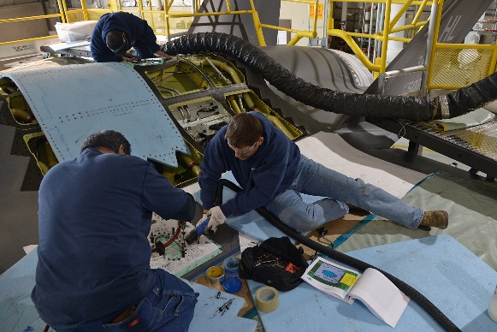
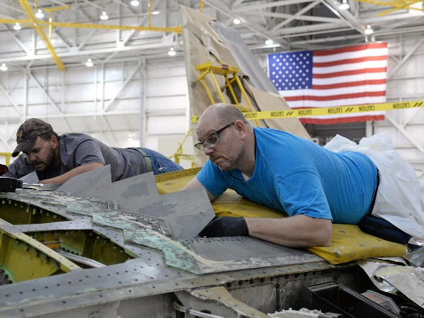
309th Aircraft
Maintenance Group
C-130
Air Force, Navy & Marines
Depot Level MX
Inspection and Repair
A-10
Modernization, Structural Repair
T-38
Modernization, Structural Repair
F-16
Modernization, Structural Repair
F-35
Inspection and Repair
F-22
Corrosion, Structural Repair
Built Right, Ready to Fight
Notes:
AMXG is what you typically think of workload in a depot. They inspect and modernize aircraft. They also oversee the mechanics responsible for crash recovery for the F-16, A-10, and F-22.
Diversified type of aircraft from the older airframes of C-130 and A-10 to the modern F-22 and F-35
- Workloads differ from airframe to airframe with the biggest difference is the C-130 to the fighter and attack aircraft
C-130 workload packages closely resemble a nose to tail in-depth inspection package
F-22 is mostly corrosion control modifications to address corrosion issues associated with dissimilar metals
The T-38 workload is at Randolph
Keeping the A-10 airworthy has been a deliberate effort with the mechanics and program office
- F-16 has been the steady workload for Hill for many years.
Began the first depot activation site for the F-35

Slide 16
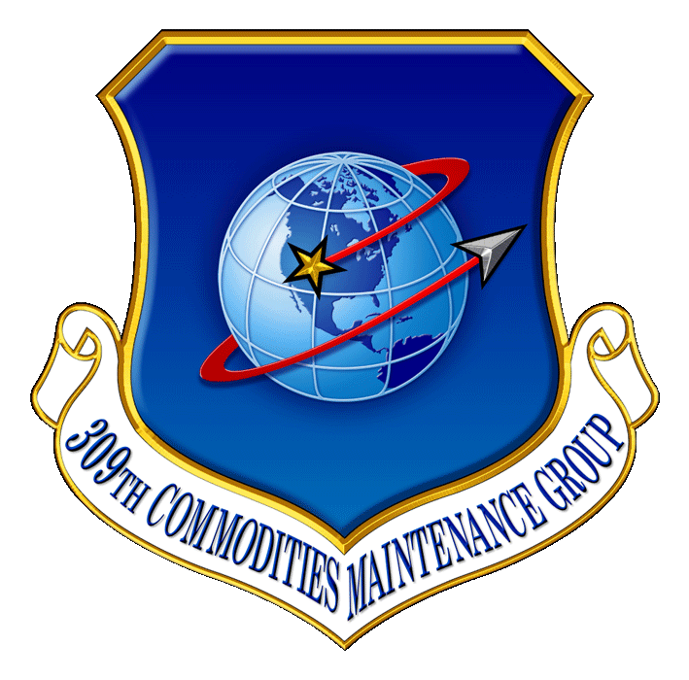
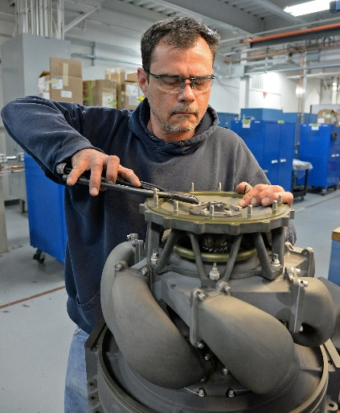
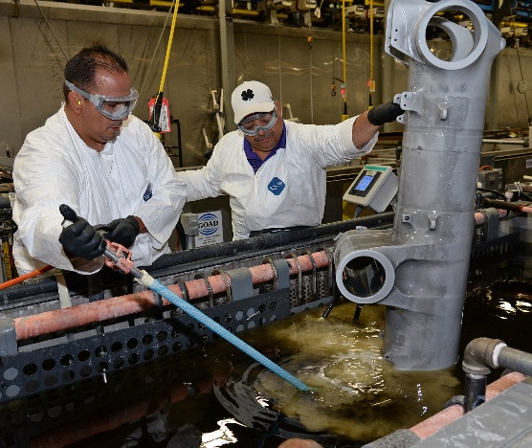
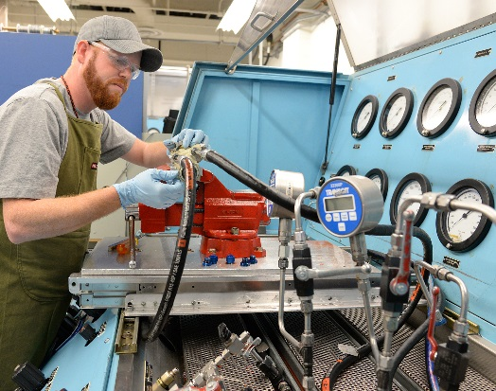
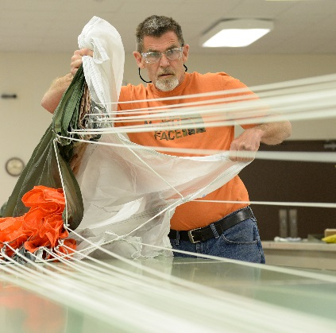
309th Commodities Maintenance Group
Power Systems
Landing Gear
Gas Turbine Engines
Auxiliary Power Units
Jet Fuel Starters
Gearboxes
PTO Shafts
Landing Gear
Center of Excellence
Wheels & Brakes
Specialized Thermal
Spray Coatings
Over 70,000 components overhauled and repaired
Commodities
Technical Repair
Structures
Canopies
Composites
Center of Excellence
Textiles/Rubber
Low Observables
Egress/Life Support
New Manufacturing
Hydraulics
Pneudraulics
Armament
EPU/Hydrazine
Pylons/Tanks
Built Right, Ready to Fight

Slide 17
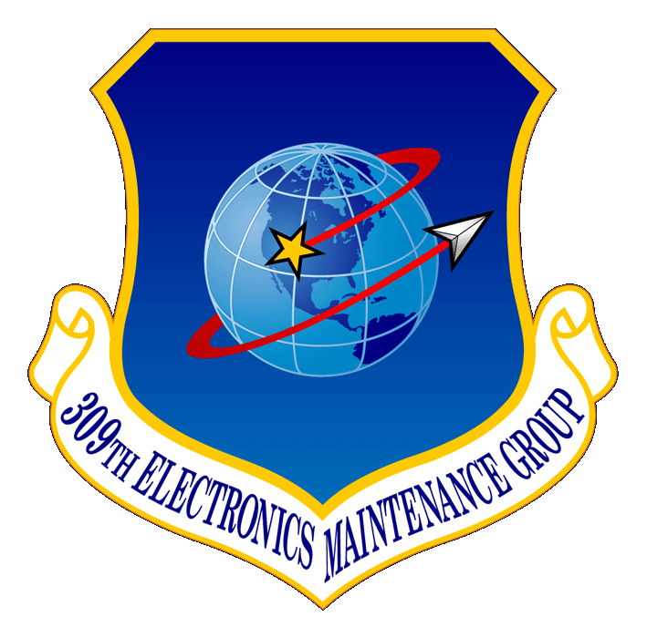
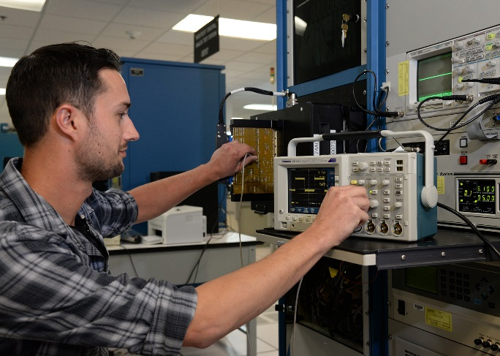
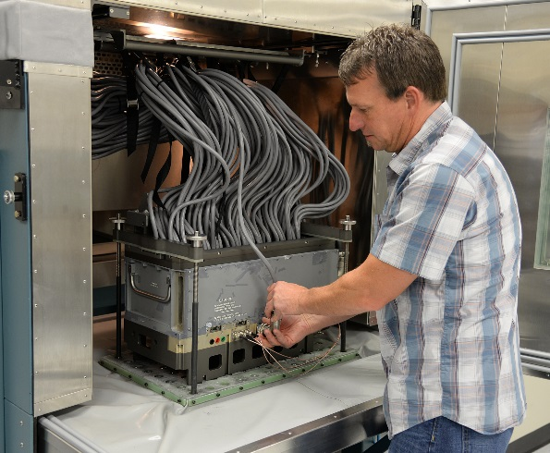
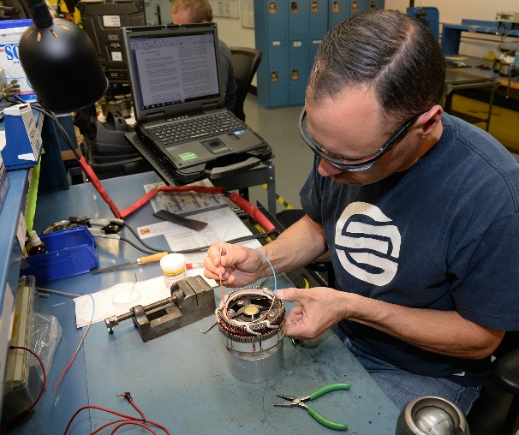
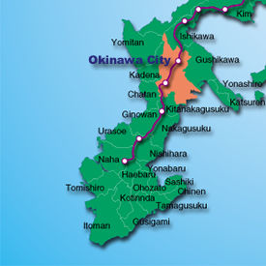
309th Electronics Maintenance Group
Electronics and Instruments
Avionics
Generators
Support Center Pacific
Built Right, Ready to Fight

Slide 18
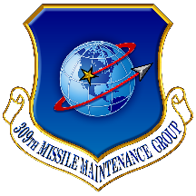
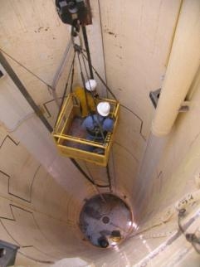
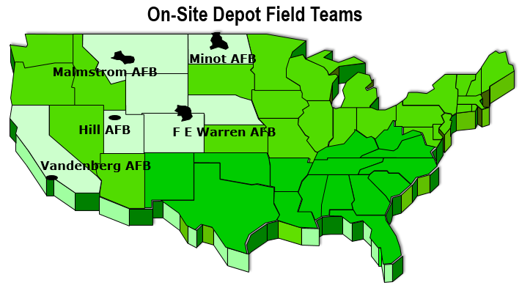
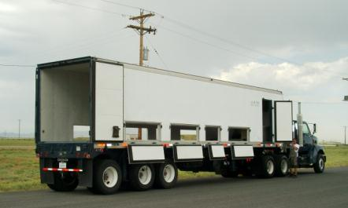

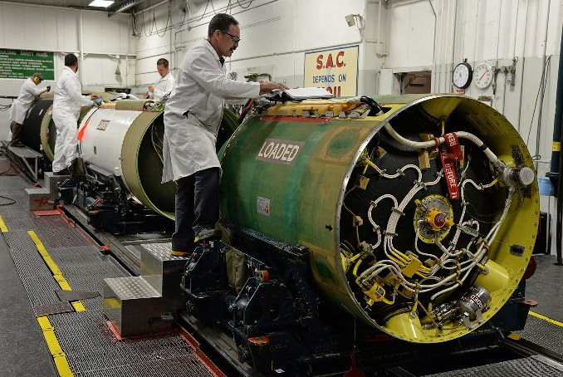
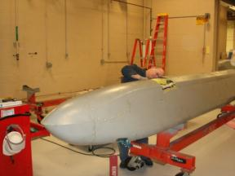
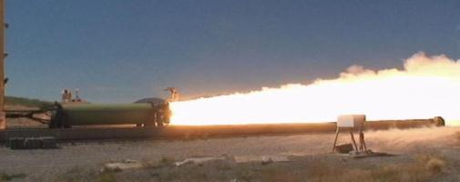
309th Missile
Maintenance Group
Transportation
LF PDM
Future Workload
Munitions Test
ALCM
MMIII PDM
Built Right, Ready to Fight
Notes:
This slide shows some of the missions within the 309th Missile Maintenance Group
Clockwise starting at top left:
LF PDM shows the inside of an operational Minuteman III Launch Facility (LF) undergoing PDM. We also perform PDM on operational Launch Control Centers as well as support equipment including Transport/Erectors and Payload Transporters
The map of the On-Site Depot Field Teams shows the locations of our Geographically Separated Units (GSUs) which perform the PDM mission at each operational missile wing.
Upper right corner is a Missile Transporter (MT) used to transport the 69,000 lbs MMIII downstage to and from the field units
The MMIII PDM picture shows an LGM-30G booster undergoing depot level maintenance in 309 MMXG facilities. The unit also services the Propulsion System Rocket Engine which serves as the fourth stage of the Minuteman III ICBM
Munitions Test is a picture of a static fire at the Utah Test and Training Range
The lower left photo is an AGM-86B Air Launched Cruise Missile (ALCM). The 309 MMXG performs Service Life Extension on this weapon system as well as PDM on support equipment like the MHU-196 Missile Handling Trailer.

Slide 19
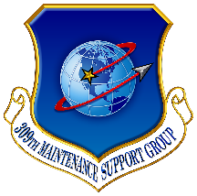
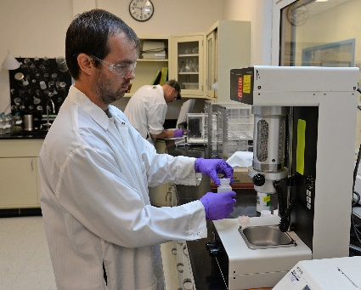








309th Maintenance
Support Group
10,000+ Pieces Industrial
Plant Equipment
Environmental, Material, Chemical & Failure Analysis Labs
Paint and Blast
T38 Lever Fluorescent Penetrant Inspection
3D Printing
First Article Testing
Non-Destructive Inspection Including Computed Tomography & Dye Penetrant
Built Right, Ready to Fight
T-38 Lever Fluorescent Penetrant Inspection
Notes:
-The Maintenance Support Group provides laboratory analyses for production processes, OO-ALC weapon systems, and world-wide customers
-In direct support to DLA we provide first article testing on aerospace parts and components to ensure their viability in the MX operations
- As part of their NDI capability, MXSG operates the largest and most powerful CT facility in the world
-- Used for non-destructive testing of ICBM missile motors, it has also been used for commercial applications such as worm-hole studies associated with oil drilling and marine-life studies looking at the long-term effects of sonar.

Slide 20





309th Software
Engineering Group
World-class Software Production
  Operational Flight Programs
  Space Systems Software
  Test Software
  Command Control Communication
  Automatic Test Equipment Software
  Provider of Choice for Weapon System Software Development & Sustainment
Built Right, Ready to Fight
Notes:
SMXG has an exciting array of workloads that include:
Operational Flight Programs for the F-16, A-10, and F-22
Mission Planning software with near real time friend and foe ID overlays
Upgrades to Automatic Test Stations used to repair weapon system electronic systems
C3I systems, including the Ground Theater Air Control System used to protect our nation’s Capital during 9/11
Space systems such as MILSTAR, Global Broadcast System, Radar Open Systems Architecture and more…
Flight line support systems such as our state of the art OFP loader/verifier know as the Command Aircraft Reprogramming Equipment (CAPRE)
Solar Electro Optical Network (SEON) suite of products to monitor the sun’s activities
And much more…..
With over 65 projects, SMXG engineers are afforded the opportunity to engage in virtually any aspect of electrical and computer engineering and can often be found integrating state of the art technologies into our nation’s weapon systems.
The efforts of our talented engineers keeps our war fighting edge sharp and gives our ground forces that extra edge to successfully engage the enemy with minimal collateral damage and virtually no civilian casualties.

Slide 21

Team Hill AFB Depends on Higher Education to Recruit and Retain
Team Hill AFB Composition
  Largest single-site employer in the state of Utah
  Professional Positions - 3K
  Technical, Administrative, Clerical Positions - 10K
#1 Recruiting Sources
  Accredited Universities
  Technical Colleges
Higher Education improves Retention
  Pay Increases
  Job Satisfaction
  Career Progression

Slide 22


Notional Paths for a...
Composites Technician Materials/Industrial/Mechanical Engineer
ATC Certificate
(Composites Technician)
Employment Opportunities, including...
- Aerospace/Defense/Recreational composites
- MRO of composite aerospace systems
- Ready-made path & skills to succeed in BS program
Employment/
Grad School
9 10 11 12 Fr So Jr Sr
HS
AS
BS
High School CTE Courses
(Manufacturing, Metalworking, Composites)
IT/Software Technician IT Professional, Elec/Comp Engineer, Computer Scientist
ATC Certificate
(IT, Programming Languages)
Employment Opportunities, including...
- IT, Systems Admin, Cyber
- Software Programming/Maintenance
- Ready-made path & skills to succeed in BS program
Employment/
Grad School
9 10 11 12 Fr So Jr Sr
HS
AS
BS
High School CTE Courses
(IT, Computer Science, Programming)

Slide 23
Continued Partnership
Continued collaboration of articulation of tech school programs to universities
Communication of government business practices
Synergy between all Higher Education
Best Practice?

Slide 24

Follow us on
Facebook: Hill_AFB_Recruiting
Instagram: HillAFB­_Recruiting
LinkedIn: Hill Air Force Base Recruiting
AFSCCivilianCareers.com
Built Right, Ready to Fight
Questions

